Slide 1
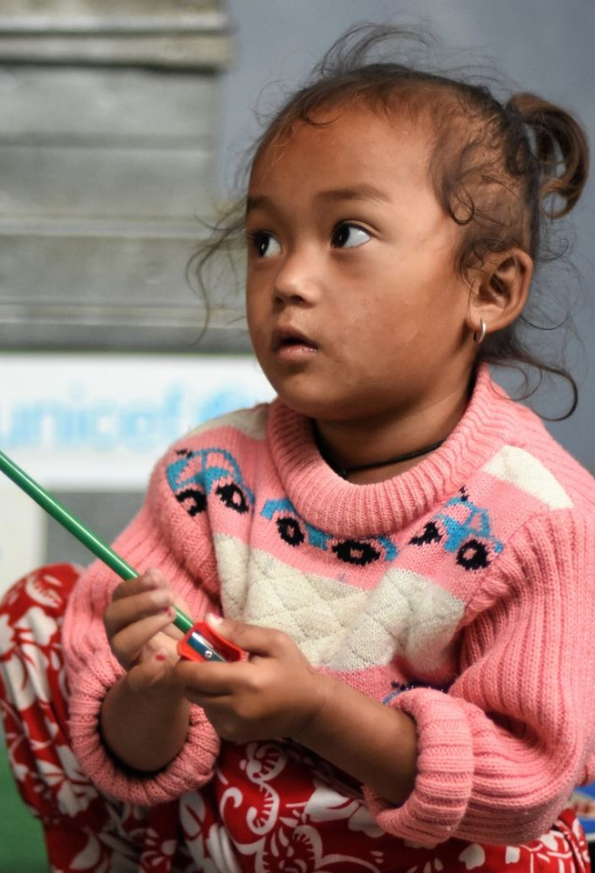


Child and Family Tracker
Tracking the Socio-Economic Impact of COVID-19 on Children and Families in Nepal
4th Monthly Household Survey
October 2020 Findings

Slide 2
Content
Household characteristics
(gender, ethnicity, caste, place of residence, age, disability)
Immediate needs
Government assistance and social protection
Loss of jobs/livelihoods
Nutrition
WASH
COVID-19 knowledge and behaviour
Returnees
Household earnings
Education
Protection of and violence against women and children
Health
This is the fourth in a series of monthly household surveys to track the socio-economic multi-sectoral impact of COVID-19 on children and families in Nepal.​
​
Where available, the monthly household survey data is supplemented by relevant child-related data from other sources.

Slide 3
Survey Design
Telephonic survey and interactive voice responses with follow up questions.
Sample size: 6,588 households with children. Households are selected through random and purposive sampling.
The sample covers 80+% of municipalities (624). Strong geospatial representation to allow interpolation to non-observed areas.
Sample remains nationally and provincially representative of households with children.
Interviewed caregivers: 49% female and 51% male.

Slide 4
Highlights of Findings
61% of respondents are not earning or earning below 10k NPR per month and are at significant risk of falling into poverty. Major needs of families continue to be financial assistance, children’s education, employment and food.
Government assistance has decreased from 20% in July and August to only 1% in October. Social security allowances declined from 20% to 15%.
20% of families report children not studying. Online classes are beset with disruptions of internet connections and a significant number of children are not able to follow these classes. Only 49% of households are confident about sending their children back to school.
20% of respondents report struggling to obtain enough food – unchanged from August. In 11% of families, children were eating less than before.

Slide 5
Highlights of Findings
An increase in children having fever from 7% in July to 16% in October. 20% do not take their children to health facilities for treatment, typically because they are caring for or treating the children themselves. 25% face difficulties in accessing treatment. 11% of children with a fever are still not well.
89 newborn babies reported in October, compared to 72 in August. Shift in preference for ‘nearest’ health facility as place to deliver.
12% of households are having difficulty accessing hygiene materials such as soap and detergent.
Increase in percentage of families witnessing violence against women and children.
49% of respondents felt at risk of infection from COVID-19 and only 57% could maintain a 2 metre distance in public all or most of the time.

Slide 6
REPORTED INCOME DISTRIBUTION COMPARED ACROSS THE FOUR SURVEYS SHOWS A SLIGHT IMPROVEMENT IN OCTOBER COMPARED TO AUGUST – BUT 61% HHs STILL AT RISK OF POVERTY
Reported income distribution recovered slightly in October compared to August but is still significantly worse than May or July.
In October, 61% of households are at significant risk of income poverty.
Majority of those who remain in the no earnings category from August to October were from Sudurpaschim and Province 5, are likely to be living in rural areas, and 25% are from female headed households. More than 10% are likely to be Dalits.
Distribution of respondents
across income groups

Slide 7
DECREASING TREND OBSERVED IN LOSS OF JOBS/WORK/LIVELIHOODS
% of respondents reporting loss of work or livelihood is on a decreasing trend since July
45% of respondents report a loss of work or livelihood in October.
Even though fewer losses are reported, earnings are still low and depressed.
Most job losses accrue to male heads of households in rural municipalities.
Results from other surveys such as the Interactive Voice Response reveal that nearly one in five respondents across the four rounds of the Tracker had to resign from their job due to COVID-19.
Percentage reporting loss of job/work/livelihood (N=2091 of all four survey rounds)

Slide 8
EXCEPT FOR KARNALI, ALL PROVINCES EXPERIENCED A DECLINE IN LOSS OF JOBS OR LIVELIHOODS COMPARED TO PREVIOUS TRACKER SURVEYS
Compares losses in baseline (loss0) with losses in July follow-up (loss1), August follow-up (loss2) and October follow-up (loss3) across the Provinces
Province 3 and 5 recorded the lowest percentage of job and livelihoods loss compared to the August survey.
Province 2 remains an outlier and shows the least improvement compared to other provinces.

Slide 9
FINANCIAL COPING BEHAVIOUR SHOWS AN UPWARD TREND OF BORROWING AND IN CUTTING EXPENDITURES, AND A DOWNWARD TREND IN DEPLETION OF SAVINGS.
Increasing indebtedness against continued and significant poverty risks.
61% of Dalit respondents report having to borrow as a financial coping mechanism compared to 48% for non-Dalit respondents and 49% nationally.
Female headed households tend to deplete their savings less, rely more on friends and family, and are much more likely to be receiving remittances.
Selling of assets is also on the rise. The percentage responding ‘none’ has fallen significantly.
In October approximately 5% of respondents received remittances while another 17% received some salary. 2% received some pension (not included in earlier rounds).
As per recent government reports, remittances have not contracted as sharply as expected and hence households are reporting remittances.

Slide 10
IN OCTOBER, THE TOP THREE NEEDS WERE CHILDREN’S EDUCATION, FINANCIAL SUPPORT AND EMPLOYMENT. IN AUGUST, THE TOP THREE NEEDS WERE FINANCIAL SUPPORT, CHILDREN’S EDUCATION AND FOOD.
Notable increase in the percentage of respondents declaring children’s education as their top three immediate needs.
Decline in percentage of respondents needing food immediately, from 34% to 30%.
Just under 10% of respondents report medications as an immediate need.
Percentage requiring no immediate needs declined from 26% in August to 23% in October.
Percentage reporting yes for each category of household needs

Slide 11
OCTOBER SAW A SHARP FALL IN GOVERNMENT ASSISTANCE AND A DROP IN SOCIAL ASSISTANCE RECEIPTS
Significant decline in percentage of households reporting they received any government assistance from 21% in May and July to 1% in October.
Recipients most likely to be from Province 3 and Karnali and female headed households. Dalit respondents more likely to receive government assistance in October.
Decline in percentage of respondents receiving social security allowances.
8% reported difficulty receiving social security allowances, because:
Travel multiple times
Bank hours and timings uncertain
Lack of transport
Fear of travel.
Percentage reporting receiving government assistance (any form)
Percentage receiving any social security allowances

Slide 12
ALL PROVINCES REPORTED A REDUCTION IN SOCIAL SECURITY ALLOWANCES
In all provinces – there is a drop compared to May or July.
Sudurpaschim Province reporting the highest percentage of respondents receiving social security allowances, and also the highest reduction.
Social security allowances are paid in tranches – so care is needed in interpreting this.
Percent reporting social security assistance
- by province

Slide 13
AMONG RESPONDENTS RECEIVING SOCIAL SECURITY ALLOWANCES – THE OLD AGE PENSION, WIDOWS AND SINGLE WOMEN’S ALLOWANCES AND THE CHILD GRANT ARE THE MOST COMMON
Receipt of child grant - by ethnicity (% receiving)
Most families report receiving old age social security allowances (50-53%) followed by widows and single women’s allowances (26-29%), then child grants (18-25%).
Increase in the percentage of households reporting receipt of child grants from 18% in May to 25% in July and 23% in October. 43% of Dalit respondents report receiving child grants.
Significant decline in percentage of households reporting receipt of disability allowances.
Percentage reporting different types of social security allowances

Slide 14
SMALLER SHARE OF RESPONDENTS REPORTING RETURNEES IN OCTOBER COMPARED TO EARLIER SURVEY ROUNDS. RETURNEES ARE MOSTLY INTERNAL. EXCEPT FOR PROVINCE 4, ALL OTHER PROVINCES SAW A DECLINE IN THE SHARE REPORTING RETURNEES. RESPONDENTS FROM SUDURPASCHIM HAVE REPORTED THE HIGHEST SHARE OF RETURNEES ACROSS THE SURVEYS.
Percent of respondents reporting returnees
Distribution of returnees
- by source
Distribution of returnees
- by province

Slide 15
EDUCATION: 81% OF RESPONDENTS REPORT THAT ALL THEIR CHILDREN ARE STUDYING. RESPONDENTS FROM PROVINCE 2 AND SUDURPASCHIM WERE LESS LIKELY TO REPORT ALL THEIR CHILDREN AS STUDYING.
How many children are studying?
Breakdown of studying status - by Province
Most children who are not studying are 13 to 17 years old and typically boys

Slide 16
EDUCATION: WHERE AND HOW CHILDREN ARE STUDYING
Percentage reporting yes for where children are studying
Percentage reporting yes for how children are studying
Regarding 'where' children are studying, 70% of respondents report their children are studying on their own at home. Distance learning from home was reported by 22% of respondents. Some respondents also chose community schools and private schools. Regarding ‘how’ children are studying, most respondents reported self-study and internet/online with schools.

Slide 17
EDUCATION: HOW CHILDREN ARE STUDYING DEPENDS ON WHERE THEY ARE STUDYING. EXCEPT FOR COMMUNITY SCHOOLS AND PRIVATE SCHOOLS THAT HAD REOPENED, HOME-BASED STUDY REMAINS THE PREDOMINANT FORM OF LEARNING
Examines how children are studying based on where they were studying.
Multiple response for where and how children are studying.
Home schooled: self-study at home (65%).
Distance learning: online (88%).
Private tuition: home tuition (44%).
Community schools: schools (74%).
Private schools: schools (78%).

Slide 18
EDUCATION: DIFFICULTIES WITH ONLINE CLASSES AND RESPONDENTS' CONFIDENCE ABOUT SENDING CHILDREN BACK TO SCHOOL WHEN THEY REOPEN
Difficulties with online classes
Confidence about sending children back to school
57% of respondents with children using online studying/internet report experiencing difficulties. Most difficulties relate to connectivity issues and electricity disruptions. However, a significant number (38%) also report their children are unable to follow online classes.
Respondents are equally divided between being confident (including very confident) and not confident of sending their children back to school. However, there is a strong variation in the confidence factor according to background characteristics such as income and the education level of the head of household.

Slide 19
EDUCATION: RESPONDENTS WHERE HEAD OF HOUSEHOLD HAS 12+ YEARS OF SCHOOLING, BELONGING TO UPPER INCOME GROUPS AND LIVING IN SUB-METROPOLITAN AND METROPOLITAN CITIES WERE LEAST CONFIDENT OF SENDING CHILDREN BACK TO SCHOOL
Respondents confidence level regarding sending child back to school after reopening
- by residency type (left), education level of head of household – no. of years (top right), and income group (bottom right) and

Slide 20
PROTECTION: AN INCREASE IN THE PERCENTAGE OF RESPONDENTS WITNESSING VIOLENCE AGAINST WOMEN AND CHILDREN
Witnessing violence against women and children
- by province (above) and by type of residency (bottom left)
Witnessing violence against women and children
Respondents witnessing violence against women increased from 3% in August to 3.6% in October.
Respondents witnessing violence against children increased from 0.9% to 1.3%.
Respondents witnessing violence against both women and children declined from 2.4% to 0.9%.
Respondents witnessing violence against women, children or both in rural municipalities is about 7% compared to 4% in metropolitan and sub-metropolitan municipalities.
Respondents witnessing violence against women, children or both in Province 2, Karnali and Sudurpaschim is 8% - higher than other provinces.

Slide 21
PROTECTION: DOMESTIC VIOLENCE, SEXUAL ABUSE AND PSYCHOLOGICAL OR EMOTIONAL VIOLENCE ARE THE MAIN PROTECTION RISKS FACING WOMEN AND CHILDREN
Types of discriminatory/violent behaviour towards women
Types of discriminatory/violent behaviour towards children
Most prevalent forms of discriminatory and violent behaviour towards women are domestic violence, shouting and insulting, and threats and intimidation.
Most prevalent forms of discriminatory and violent behaviour towards children are shouting/scolding, physical violence, physical or sexual abuse and child labour/exploitation.
This does not take into account intersecting forms of violence.

Slide 22
PROTECTION: DAILY CARE AND SUPERVISION AND INCREASED AGGRESSIVITY OF CHILDREN ARE MAJOR PARENTING CONCERNS
Primary worries regarding welfare and safety of children
Symptoms being shown by children

Slide 23
PROTECTION: ADULTS EXPERIENCING STRESS AND FEAR, AND CHILDREN CONTINUE PLAYING WITH THEIR FRIENDS BUT SPENDING LESS TIME SLEEPING DURING LOCKDOWN
67% of respondents report feeling stressed and 57% are afraid to go out to buy food, medication or run errands due to their fear of catching COVID-19. These results are from randomly selected respondents from the Child and Family Tracker's sample in all four rounds. The percentage of respondents feeling stressed and experiencing fear increased in October in comparison with previous rounds of the survey.
While the majority of respondents feel stressed and experience fear, more than 50% of them allow their children to continue playing with their friends. The percentage of respondents who feel comfortable allowing their children to play with their friends has gradually increased since May. Also, in each round of the survey the percentage of respondents reporting that their children spend less time sleeping has increased since May. Combined results from all four rounds of interactive voice responses show that in total 56% of respondents’ children spent less time sleeping due to lockdown.

Slide 24
NUTRITION: 1 IN 5 HOUSEHOLDS ARE NOT GETTING SUFFICIENT FOOD FOR DAILY MEALS​
20% of households report that they struggle to provide sufficient food for their family on a daily basis - no change since last survey in August.
Provinces 1, 2 and 5 have more households struggling to provide sufficient food in October compared to August.
Not enough money and increased food prices are two main reasons why families are not able to provide sufficient food on a daily basis.
WFP’s Market Update #6 results indicate that compared to August, October 2020 retail prices of vegetables such as potatoes, cabbages, tomatoes and cereals (mainly coarse rice) show a sharp increase. This is consistent with the reasons given by respondents for not being able to get sufficient food for their families to consume.
Food prices being reported as a barrier to getting sufficient food in Provinces 2, 6 and 7 is consistent with WFP's market analysis findings, which also show essential commodities cost more in these provinces.
Percentage of households reporting struggling to provide sufficient food for family - by province
Reasons for struggling to provide sufficient food for family - by province

Slide 25
NUTRITION: SINCE MAY 20-25% OF CHILDREN HAVE BEEN EXPERIENCING REDUCTIONS IN THEIR DIETARY INTAKE (MOSTLY REDUCED VARIETY). MORE THAN 1 IN 10 HOUSEHOLDS REPORT THEIR CHILDREN ARE EATING LESS. THE SHARE OF HOUSEHOLDS WHERE CHILDREN ARE EATING LESS THAN USUAL IS HIGHEST IN PROVINCE 2 AND KARNALI.
Changes in dietary intake (May-October)
Percentage eating less - by province

Slide 26
NUTRITION: EXAMINING CHANGES IN DIETARY INTAKE THROUGH DIFFERENT LENSES (WHETHER FOOD WAS AMONG TOP THREE IMMEDIATE NEEDS, HOUSEHOLD STRUGGLING FOR FOOD, AND WHETHER CAREGIVERS ARE WORRIED THEIR CHILD/REN ARE BECOMING TOO THIN)
Changes in dietary intake in October
- by whether the respondent declared food as one of the top three immediate needs
Changes in dietary intake
- by whether the household declared struggling for food or not
Changes in dietary intake
- by whether the household was worried about their children becoming too thin
Households declaring food as one of their top three immediate needs have a higher proportion of children eating less variety of foods, less amounts of food and less often.
Households struggling to provide enough food on a daily basis have a higher proportion of children eating less variety of foods, less amounts of food and less often.
44% of those households worried about their children becoming too thin also reported reductions in their child’s dietary intake, eating less variety of food, less amounts of food at mealtime and less often.
Notes:
35% OF THOSE WHO DECLARED FOOD AS AN IMMEDIATE NEED REPORTED REDUCTIONS IN THEIR CHILDREN’S DIETARY INTAKE COMPARED TO 19% FOR THOSE THAT DID NOT. MORE THAN 64% OF THOSE WHO REPORTED STRUGGLING FOR FOOD REPORTED REDUCTIONS IN THEIR CHILDREN’S DIETARY INTAKE COMPARED TO 14% FOR THOSE WHO DID NOT. 44% OF THOSE WHO WERE WORRIED ABOUT THEIR CHILDREN BECOMING TOO THIN REPORTED REDUCTIONS IN DIETARY INTAKE VERSUS 21% FOR THOSE THAT WERE NOT. IN ALL THESE CASES THE DIFFERENCES ARE SIGNIFICANT

Slide 27
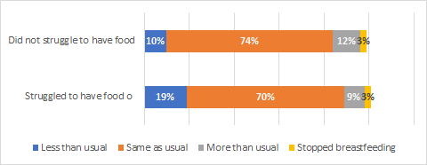
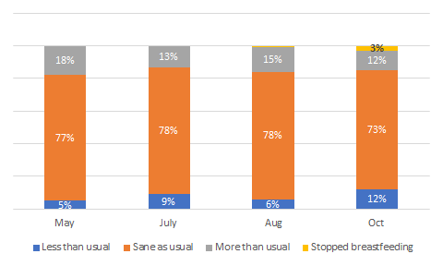
NUTRITION: BREASTFEEDING FREQUENCY – A DECREASE IN THE SHARE USUAL BREASTFEEDING, INCREASE IN THE SHARE BREASTFEEDING LESS THAN USUAL AND DECREASE IN THE SHARE BREASTFEEDING MORE THAN USUAL. RESPONDENTS WHO REPORTED STRUGGLING FOR FOOD WERE MORE LIKELY TO REPORT BREASTFEEDING LESS THAN USUAL.
Changes in breastfeeding by whether respondents struggled to have food on a daily basis
In October, 73% of respondents report breastfeeding at the same frequency, 12% breastfeeding less than usual and 12% breastfeeding more than usual.
This reflects a reduction in the proportion of mothers breastfeeding more than usual and an increase in the percentage of mothers breastfeeding less than usual.
The decrease in mothers breastfeeding less than usual may be influenced by increased mobility of mothers as lockdown was lifted.
Mother’s stopped breastfeeding due to:
Perception of not enough breastmilk (47%)
Do not want to breastfeed anymore (27%).
Household availability of food may be influencing mothers breastfeeding practices, with those struggling to get enough food on a daily basis, breastfeeding less frequently than usual ,and some choosing to stop early thus not completing the recommended duration of up to two years or more.
Changes in breastfeeding frequency

Slide 28
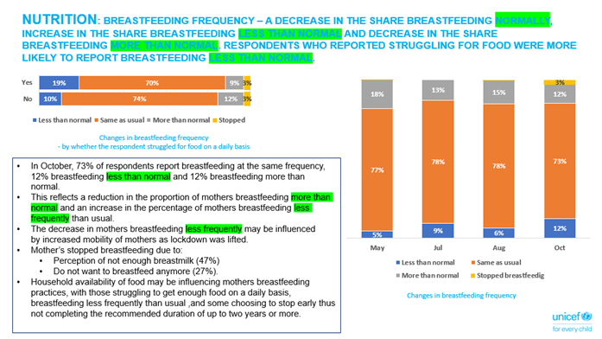

Slide 29
NUTRITION: DESPITE GLOBAL RECOMMENDATIONS ABOUT THE SAFETY OF BREASTFEEDING IN THE CONTEXT OF COVID-19, 43% OF MOTHERS ARE NOT CONFIDENT TO BREASTFEED IF SUSPECTED OR DIAGNOSED WITH COVID-19. PROVINCE 2 RESPONDENTS HAD THE HIGHEST PERCENTAGE REPORTING NOT BEING CONFIDENT. RESPONDENTS FROM ALL PROVINCES MISTAKENLY BELIEVE BREASTFEEDING IS NOT SAFE IN COVID-19 CONTEXT.
Confident or not about continuing to breastfeed if diagnosed with COVID-19
- by province (left) and reasons for not feeling confident (right)

Slide 30
BEHAVIOUR AND KNOWLEDGE: CONTINUED UPWARD TREND IN THE PERCENTAGE OF RESPONDENTS REPORTING 'HEARING MESSAGES ABOUT BRESATFEEDING' IN THE CONTEXT OF COVID-19 FROM 12% IN MAY TO 25% IN OCTOBER.
PROVINCE 2 RESPONDENTS ARE LEAST LIKELY TO HAVE HEARD ABOUT THESE MESSAGES, WHICH MAY EXPLAIN WHY THERE ARE MORE MOTHERS IN PROVINCE 2 NOT CONFIDENT TO BREASTFEED IF SUSPECTED OR DIAGNOSED WITH COVID-19.
Respondents (%) hearing messages about breastfeeding in the context of COVID-19
Respondents (%) hearing messages about breastfeeding in the context of COVID-19

Slide 31
BEHAVIOUR AND KNOWLEDGE: OVERWHELMING MAJORITY REPORTED HEARING MESSAGES ABOUT BREASTFEEDING IN THE CONTEXT OF COVID-19 FROM RADIO (72%), FOLLOWED BY TV (34%) AND FACEBOOK (11%). WASHING HANDS BEFORE BREASTFEEDING AND WEARING MASKS ARE THE TOP TWO MESSAGES THAT WERE RECALLED. A SIGNIFICANT NUMBER ALSO REMEMBERED THE MESSAGE THAT 'IT IS SAFE TO BREASTFEED AND THAT COVID-19 IS NOT TRANSMITTED THROUGH BREASTMILK'.
Sources from where respondent recalled hearing messages
(% responding yes)
Which messages recalled the most

Slide 32
NUTRITION: THERE IS A DECREASE OVER THE PAST THREE MONTHS IN THE PROPORTION OF CAREGIVERS WORRIED THAT THEIR CHILDREN ARE BECOMING TOO THIN​.
AMONG HOUSEHOLDS STRUGGLING TO PROVIDE FOOD ON A DAILY BASIS, THERE ARE SIGNIFICANTLY MORE CAREGIVERS WORRIED THAT THEIR CHILD/REN ARE BECOMING TOO
THIN (25%). ​GENERALLY THERE IS GREATER CONCERN FOR BOYS THAN GIRLS, WITH THE EXCEPTION OF THE 10-12 AGE GROUP.
Worrying about children becoming too thin
Worrying about children becoming too thin and struggling for food
Gender and age group of children being worried about

Slide 33
WASH: 12% OF RESPONDENTS HAD DIFFICULTY IN ACCESSING HYGIENE PRODUCTS WITH RESPONDENTS IN RURAL MUNICIPALITIES, SUDURPASCHIM, BAGMATI AND THOSE THAT DID NOT EARN ANY INCOME BEING SIGNIFICANTLY MORE AT RISK. OVER 90% OF RESPONDENTS REPORTED USING EXISTING FACILITIES WITH A SMALL NUMBER REPORTING REPAIRING AND/OR ADDING NEW ONES. THIS CONFIRMS AN UPWARD TREND SINCE MICS 2019. SOAP AND OTHER DETERGENTS WERE THE HYGIENE ITEMS MOST DIFFICULT TO ACCESS.
Action | Toilet | Hand washing station
Built new | 2% | 2%
Repaired | 2% | 3%
Added new |  | 5%
Using existing one | 96% | 91%
Sharing with other families | 1% | 1%
Difficulty/No access | 1% | 1%
Respondents (%) reporting having difficulty accessing hygiene products - by location of residence
The data triangulate well with MICS 2019 data for access to improved toilet facilities (both not-shared and shared) which is 94.5% in MICS and shows a slight increase. The MICS data also shows 80% with access to a handwashing station with soap and hence a 11% increase can be expected in the current context of COVID-19.
Hygiene products and difficulty in accessing (of the 12% who had difficulty)
Respondents (%) reporting having difficulty accessing hygiene products - by province (left) and income group (right)

Slide 34
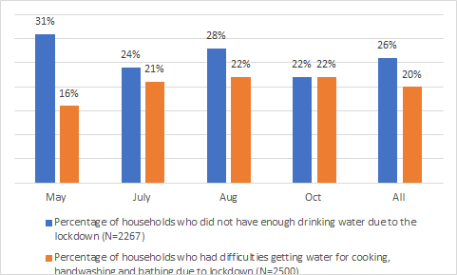
WASH: FINDINGS FROM INTERACTIVE VOICE RESPONSES FROM RANDOMLY SELECTED HOUSEHOLDS IN MAY, JULY, AUGUST AND OCTOBER INDICATE SOME IMPROVEMENT SINCE THE FIRST ROUND IN TERMS OF DRINKING WATER, BUT NOT FOR ACCESS TO WATER FOR COOKING, BATHING AND HANDWASHING
Results from randomly selected households for follow up questions show that the percentage of those who did not have enough drinking water decreased from 31% in May to 22% in October. However, the percentage of households with limited access to drinking water increased from 24% in July to 28% in August and decreased again by 6% in October. In total, 26% of households had limited access to drinking water in the last six months.
The percentage of households who had difficulty getting water for cooking, handwashing and bathing increased from 16% in May to 22% in October. The rate has remained constant since July.
Access to drinking water, handwashing, bathing and cooking
(May – October 2020)

Slide 35
HEALTH: 16% OF RESPONDENTS REPORTED THEIR CHILDREN HAVING A FEVER RECENTLY COMPARED TO 7% IN JULY. RESPONDENTS FROM SUDURPASCHIM AND PROVINCE 2 WERE MOST LIKELY TO REPORT CHILDREN HAVING A FEVER RECENTLY.
Respondents (%) reporting children with fever recently
Respondents (%) reporting children with fever recently
- by province (October)

Slide 36
HEALTH: 80% OF RESPONDENTS TOOK THEIR CHILDREN WITH A FEVER TO A HOSPITAL. A QUARTER OF THEM REPORTED HAVING DIFFICULTY IN GETTING TREATMENT. THE MOST PREVALENT REASONS FOR NOT TAKING CHILDREN TO A HOSPITAL WERE SELF-TREATMENT AT HOME AND 'ILLNESS NOT SERIOUS'.
16% reported their children having a fever.
51% reported the fever lasting more than seven days.
80% of respondents having children with a fever took their children to a hospital.
Major reasons cited for not taking children to the hospital was that caregiver treated the child at home (60%) or they thought the illness was not serious (31%). Fear of contamination was reported by 13% of respondents as a reason for not going.
11% of children were still not well.

Slide 37
HEALTH: COMPARING RESPONDENTS' PREFERENCE IF NEEDING TREATMENT ACROSS MAY, JULY AND OCTOBER SHOWS A SHIFT IN PREFERENCE TOWARDS LOCAL CLINICS/PHARMACIES FROM HEALTH POSTS AND PRIVATE HOSPITALS
Proportion preferring health posts declined from 54% in May to 48% in October.
Proportion preferring hospitals in the city also declined, from 35% in May to 31% in October.
Proportion preferring local clinics and pharmacies increased from 5% in May to 19% in October.
Respondents' preferred place of treatment if needed

Slide 38
HEALTH: 89 LIVE BIRTHS WERE REPORTED IN OCTOBER (COMPARED TO 72 IN AUGUST).
87-89% DELIVERED IN HOSPITAL OR NEAREST HEALTH FACILITY. HOME DELIVERIES DECREASED BY 1% WHILE DELIVERIES IN PRIVATE CLINICS INCREASED BY 5%.
89 households in October (1.4% of respondents) compared to 72 households in August (1.1% of respondents) reported live births.
Over half of these births took place in the two lowest income groups.
Compared to August, there is a slight decrease in deliveries in hospitals (8%) and a more than 5% increase in deliveries in nearest health facilities and private clinics, respectively.
Of those born at home (6 cases), fear of contamination and crowded health facilities were the main reasons for opting for home delivery.
Experience regarding childbirth and care at health facility
51% of respondents report receiving extra care while 48% report that they are happy with the care they received. However, 12-13% felt they were discharged too early or had shorter interaction time with hospital staff.
Comparing place of birth in August and October

Slide 39
BEHAVIOUR AND KNOWLEDGE: IN BOTH AUGUST AND OCTOBER, 49% OF RESPONDENTS FELT THEY WERE AT RISK OF COVID-19. THOSE LIVING IN METROPOLITAN CITIES, THOSE FROM UPPER INCOME GROUPS AND THOSE FROM PROVINCE 2 AND BAGMATI ARE MOST LIKELY TO FEEL AT RISK. IN OCTOBER, 57% WERE ABLE TO KEEP TWO METERS DISTANCE IN PUBLIC ALL OR MOST OF THE TIME COMPARED TO 53% IN MAY. 6% REPORTED NOT BEING ABLE TO BUY A MASK.
Respondents (%) feeling at risk of Covid-19
Respondents (%) keeping 2 meters distance in public
Percentage of respondents who felt they were at risk of COVID-19 remained the same between August and October (49%).
Respondents from the top two income groups are more likely to feel at risk than those from the lowest two.
People living in metropolitan cities are the most likely to feel at risk.
6% reported they could not buy a mask.
Respondents from Sudurpaschim (14%) and Karnali (8%) provinces were the most likely to report difficulties.

Slide 40
BEHAVIOUR AND KNOWLEDGE: PRACTICE OF MAINTAINING TWO METERS DISTANCE VARIES STRONGLY ACROSS PROVINCES AND BY WHETHER THE PERSON PERCEIVES RISK
Province 2 has the lowest proportion responding ‘all’ or ‘most’ of the time while Gandaki has the highest.
Bagmati Province has the highest responding 'rarely' or 'never' practicing.
A major difference between those who perceive themselves to be at risk and those who do not is ‘most’ of the time those who feel at risk keeping a safe distance.
Respondents (%) keeping two meters distance in public
- by Province (left) and whether they feel at risk of being infected (right)

Slide 41
BEHAVIOUR AND KNOWLEDGE: ABILITY OF RESPONDENTS TO BUY A MASK
IN OCTOBER
94% of respondent have the ability to buy a mask if they want to, and only 6% cannot. Respondents who cannot buy a mask reason limited availability of masks at shops, increased prices or that they make their masks at home.

Slide 42
SUMMARY OF FINDINGS
Loss of Job / Livelihood
Context of tight labour markets.
Only 2% of respondents could find jobs; 45% of families report loss in earnings or livelihood.
Province 2 reports highest losses across all rounds of the survey.
Loss of Income
61% at risk of poverty, a slight improvement compared to August (64%).
Immediate Household Needs
Top four needs: financial support, children’s education, food, employment.
Government Assistance
Dropped sharply to less than 1% in October from 20% in earlier rounds of the survey.
Social Security Allowances
Dropped from over 20% in May and July to 15% in October.
8% report difficulty in accessing allowances.
% receiving child grants increased from 18% in May to 23% in October.
Education
81% of respondents report all of their children were studying, 70% studying at home, 22% distance learning at home.
Education
How studying:
Self-study 47% Online 23% School 15% Textbooks 15% Self-learning packages from govt 13%.
Education
48% not confident about sending their children back to school after they reopen. Upper income groups are least confident.
Education
38% cannot follow online classes. Internet connectivity, disruptions and electricity failures are also reported by a large majority as a problem for online classes.
Protection
Top worries about children in the community: hygiene (34%), bad company (24%), daily care and supervision (22%).
13% of respondents report their children had begun showing signs of aggression and anger.
WASH
12% have difficulty in purchasing hygiene products.
22% in Sudurpaschim. Province.
22% earning no income.
Soap and other detergents are the hygiene products difficult to access.
Protection 6% of respondents witness violence against children and/or women (3.6% VAW, 1.3% VAC, 0.8% both) 2% report child labour.
Protection
Most prevalent forms of violence against women is domestic violence (67%) and verbal abuse (46%).
Most prevalent forms of violence against children are verbal abuse (54%), physical abuse (45%) and sexual abuse (23%).

Slide 43
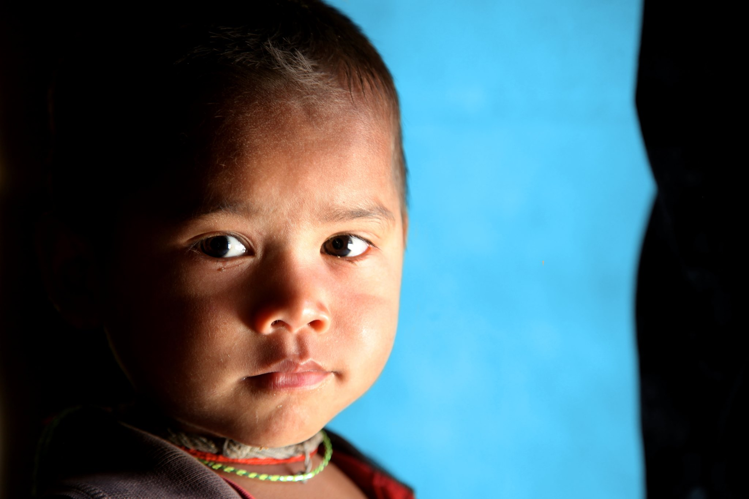



Slide 44
TRACKING THE FLOW OF PARTICIPANTS – SOME CHURNING OBSERVED BUT SAMPLE STILL COVERS MORE THAN 80% OF MUNICIPALITIES, ALL DISTRICTS AND ALL PROVINCES OF NEPAL
May (7655)
July (6521)
Aug (6675)
Sep (6588)
6128
5825
5825 all 4 interviews
458 Only 1 interview
Covering around 630-640 Municipalities across the rounds (>80%)
6521
547
462
393
172
7655
587
129
1134
388
85
221
458

Slide 45
OCTOBER FOLLOW-UP: UPDATED CHILD ROSTER - MOST CHILDREN ARE 10-18 YEARS OLD

Slide 46
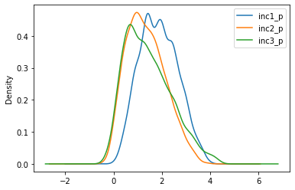
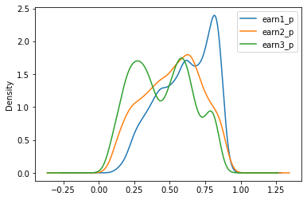
DERIVING THE DISTRIBUTION OF INCOME (L) AND PROBABILITY OF JOB/LIVELIHOOD LOSS ACROSS THE 3 FOLLOW UP ROUNDS IN JULY, AUG & OCT SHOWS INTERESTING SHIFTS AND PATTERNS. SOME IMPROVEMENT OBSERVED IN INCOME DISTRIBUTION ACROSS ALL INCOME GROUPS. HIGHER FREQUENCY OF LOW PROBABILITY JOB LOSSES IN OCTOBER.
Reporting on some simulations (Python/R). Estimated income distributions on left side using MN Logit Framework. Estimated probability of job loss on right. 1,2 & 3 refer to Jul, Aug & Sep.
Perhaps some recovery in incomes noticed when comparing Sep (inc3_p) with July (inc1_p). But significant risk of poverty (area to left of light blue line)
Bimodal distribution of job loss may suggest split labor markets. If we assume prob > 0.5 = job loss we can see the shifting patterns across the surveys (area to the left of the blue line). It is interesting to note that although the area to the left is lower in earn3_p, there is a higher frequency of low probability job losses compared to previous rounds

Slide 47
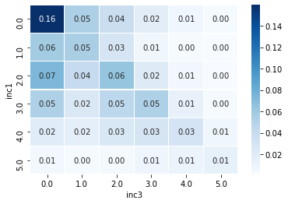
COMPARING THE DISTRIBUTION OF RESPONDENTS ALONG INCOME GROUPS IN JULY (Y AXIS) & OCTOBER (X AXIS) SHOWS THAT NEARLY 1 in 5 HOUSEHOLDS HAVE NOT EARNT ANYTHING IN BOTH JULY & SEP
Heatmap: Shows the distribution of respondents in each cell. Entire table sums to 100

Slide 48
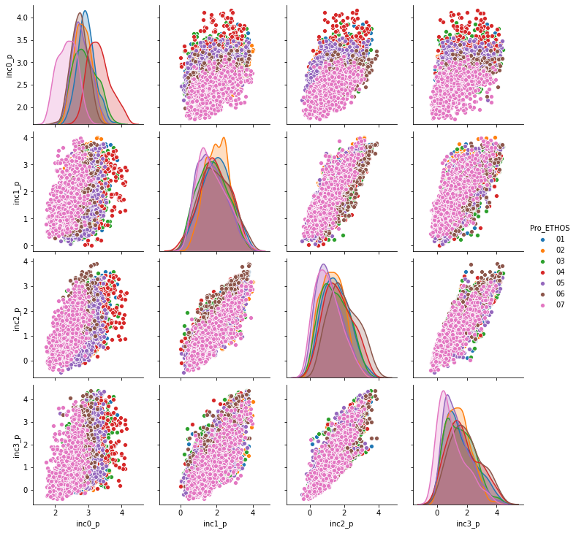

Slide 49
